Slide 1
Manish’s LLM app

Slide 2
Table of contents
Ideas
Design Choices
Repository Rundown
App methodology
Areas for improvement

Slide 3
Ideas
Essentially, the objective was to design and develop a prototype of a generative AI app that introduces myself to others. Here is the framework that I came up with
LLM provider
Input
Output
LLM framework
End-user
input/output
Prompt templates, Indexes, Chains

Slide 4
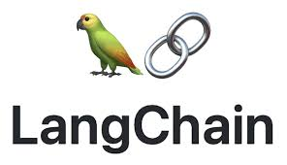


Design Choice
LLM provider
OpenAI API
Wrapper used
Langchain
Deployment
Docker (Windows is also an option for end-user local use)
Other notable additions:
Using virtual environment to ensure python package consistency

Slide 5
Methodology
load_dotenv(): loads the local environment to activate OpenAI’s API key
Instantiate llm from ChatOpenAI module
Preset some prompt template (general_data.txt) on /data folder and use a text loader to load the data
Use CharacterTextSplitter module to break up the documents into chunks
Set up a vector store using Chroma database to store the embeddings
Define a function called handle_user_input() that will display the prompt in command line and activate the llm when an input is passed

Slide 6
Repository Rundown
/data: contains the files for my prompt templates
/src: source code folder. Contains the app, “my_first_llm_app.py”
.env.example: A file to be repurposed into a .env file from the end-user once they have the OpenAI API key
.gitignore: contains the .env and .venv files
Dockerfile: Basically an instruction manual on how to create the image for the app on docker
README.md: contains instructions on how to use the app
requirements.txt: contains all the packages used in the venv python environment
run_chatbot.bat: a windows batchfile that runs the “my_first_llm_app.py” script

Slide 7
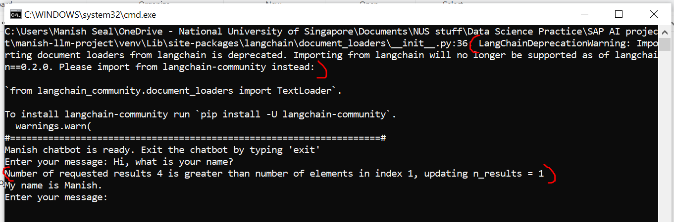
Possible improvements
Doing away with esoteric messages. E.g.

Slide 8
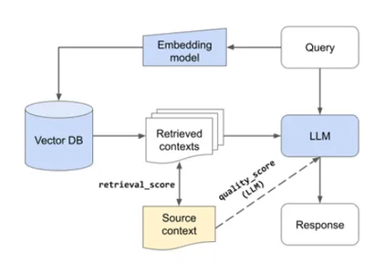
Possible improvements
Using more disparate data sources for my prompt template as opposed to just general_data.txt

Slide 9
Thank you

